Slide 1
Kubernetes basics

Slide 2
Introduction to Kubernetes

Slide 3
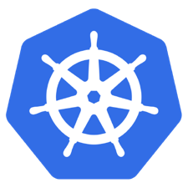
What is Kubernetes?
Container orchestrator
Runs and manages containers
Unified API for deploying web applications, batch jobs, and databases
Maintains and tracks the global view of the cluster
Supports multiple cloud and bare-metal environments
Manage applications, not machines
Rolling updates, canary deploys, and blue-green deployments
Designed for extensibility
Rich ecosystem of plug-ins for scheduling, storage, and networking
Open source project managed by the Linux Foundation
Inspired and informed by Google's experiences and internal systems
100% open source, written in Go

Slide 4
Kubernetes strengths
Clear governance model
Managed by the Linux Foundation.
Google is driving the product features and roadmap, while allowing the rest of the ecosystem to participate.
Growing and vibrant ecosystem
IBM, Huawei, Intel, and Red Hat are some of the companies making prominent contributions to the project.
Avoid dependency and vendor lock-in
Active community participation and ecosystem support.
Support for a wide range of deployment options
Customers can choose between bare metal, virtualization, private, public, and hybrid cloud deployments
Wide range of delivery models across on-premises and cloud-based services.
Design is more operations-centric
First choice of DevOps teams.
Notes:
Kubernetes has a clear governance model managed by the Linux Foundation. Google is actively driving the product features and roadmap, while allowing the rest of the ecosystem to participate.
A growing and vibrant Kubernetes ecosystem provides confidence to enterprises about its long-term viability. IBM, Huawei, Intel, and Red Hat are some of the companies making prominent contributions to the project.
The commercial viability of Kubernetes makes it an interesting choice for vendors. We expect to see new offerings announced over the next several months.
Despite the expected growth in commercial distributions, Kubernetes avoids dependency and vendor lock-in through active community participation and ecosystem support.
Kubernetes supports a wide range of deployment options. Customers can choose between bare metal, virtualization, private, public, and hybrid cloud deployments. It enjoys a wide range of delivery models across on-premises and cloud-based services.
The design of Kubernetes is more operations-centric than developer-orientated, which makes it the first choice of DevOps teams.

Slide 5
Kubernetes Concepts
5

Slide 6
Immutability
Build Once - Deploy Everywhere
The same container image is built once and is moved between environments.

Slide 7
Pods
A single unit of work in Kubernetes, which may consist of one or more containers.
All containers in a pod are co-located and co-scheduled, and share the kernel namespace (process, storage, network, etc.)

Slide 8
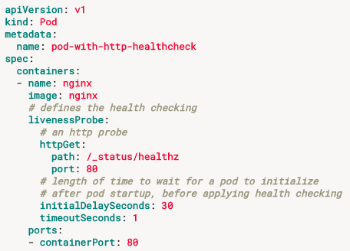
Pod Health Checking
Pods are automatically kept alive by “process check” checking the basic status of the main process for the application.
To go beyond this Kubernetes allows you to create a liveness probe to provide additional means for identifying health.
Notes:
Container probes
A Probe is a diagnostic performed periodically by the kubelet on a Container. To perform a diagnostic, the kubelet calls a Handler implemented by the Container. There are three types of handlers:
ExecAction: Executes a specified command inside the Container. The diagnostic is considered successful if the command exits with a status code of 0.
TCPSocketAction: Performs a TCP check against the Container’s IP address on a specified port. The diagnostic is considered successful if the port is open.
HTTPGetAction: Performs an HTTP Get request against the Container’s IP address on a specified port and path. The diagnostic is considered successful if the response has a status code greater than or equal to 200 and less than 400.
Each probe has one of three results:
Success: The Container passed the diagnostic.
Failure: The Container failed the diagnostic.
Unknown: The diagnostic failed, so no action should be taken.
The kubelet can optionally perform and react to two kinds of probes on running Containers:
livenessProbe: Indicates whether the Container is running. If the liveness probe fails, the kubelet kills the Container, and the Container is subjected to its restart policy. If a Container does not provide a liveness probe, the default state is Success.
readinessProbe: Indicates whether the Container is ready to service requests. If the readiness probe fails, the endpoints controller removes the Pod’s IP address from the endpoints of all Services that match the Pod. The default state of readiness before the initial delay is Failure. If a Container does not provide a readiness probe, the default state is Success.
When should you use liveness or readiness probes?
If the process in your Container is able to crash on its own whenever it encounters an issue or becomes unhealthy, you do not necessarily need a liveness probe; the kubelet will automatically perform the correct action in accordance with the Pod’s restartPolicy.
If you’d like your Container to be killed and restarted if a probe fails, then specify a liveness probe, and specify a restartPolicy of Always or OnFailure.
If you’d like to start sending traffic to a Pod only when a probe succeeds, specify a readiness probe. In this case, the readiness probe might be the same as the liveness probe, but the existence of the readiness probe in the spec means that the Pod will start without receiving any traffic and only start receiving traffic after the probe starts succeeding.
If you want your Container to be able to take itself down for maintenance, you can specify a readiness probe that checks an endpoint specific to readiness that is different from the liveness probe.
Note that if you just want to be able to drain requests when the Pod is deleted, you do not necessarily need a readiness probe; on deletion, the Pod automatically puts itself into an unready state regardless of whether the readiness probe exists. The Pod remains in the unready state while it waits for the Containers in the Pod to stop.

Slide 9
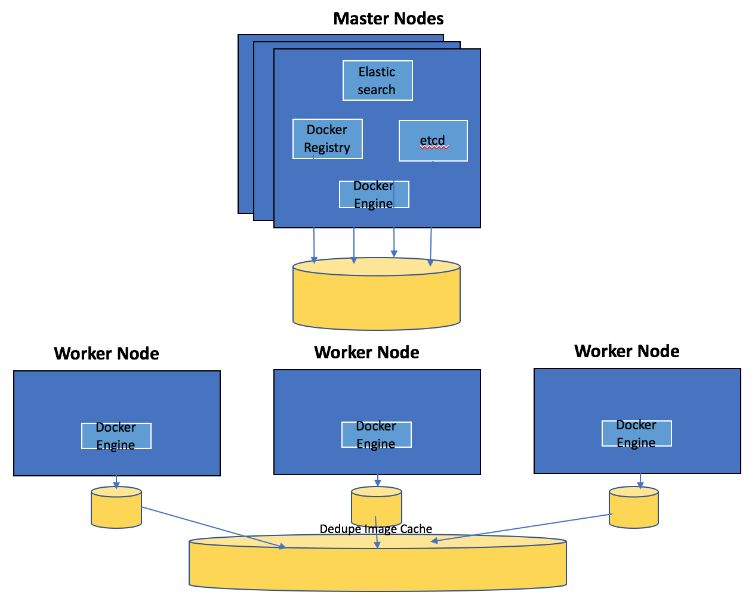
Private Image Repository
Built-in storage for your Docker images
Bundled Images Import Docker images from bundle into private registry, or import any Docker image you want to deploy across your nodes.
Secure Access Add only the images you approve of so your developers have trusted, validated images to build from.
Command so all deploying pods can access private image repo
kubectl get serviceaccounts default -o json | jq 'del(.metadata.resourceVersion)' | jq 'setpath(["imagePullSecrets"];[{"name":"admin.registrykey"}])' | kubectl replace serviceaccount default -f -
Notes:
Users can store their docker images here.. It is backed by persistent storage..
9

Slide 10
Service Discovery
Kubernetes has an internal DNS that is used as a Service Registry.
A Service resource in Kubernetes results in an entry in the internal DNS. DNS entries may point to an internal Cluster IP that load balances between healthy running service instances.

Slide 11
Config Maps & Secrets
Share and store configurations, credentials and more.
Store the configurations and secrets (credentials, certificates) in the K8s environment and mount them to the local filesystem within container(s).
The container image can move un-changed between environments (i.e. container immutability).

Slide 12
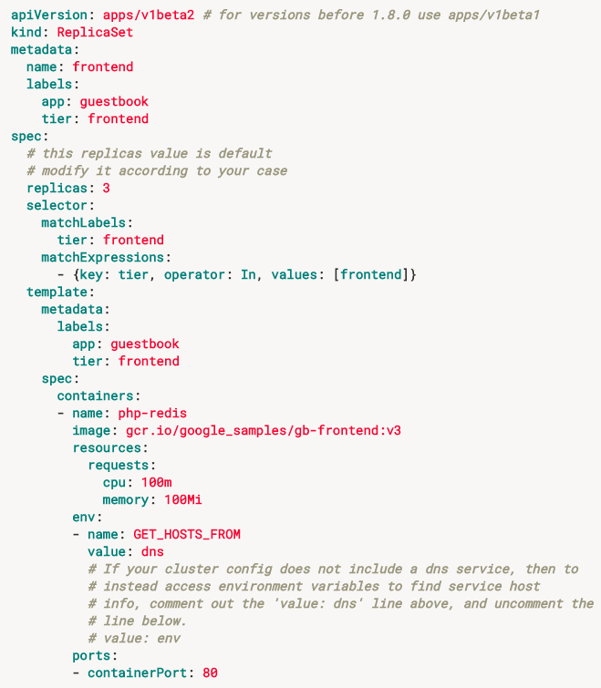
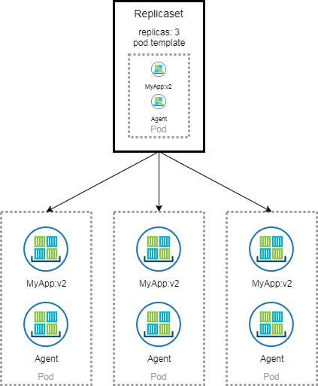
Replicasets
Scale and provide resiliency.
Replicasets run one-to-many instances of the desired pod.
When possible the replica pod should be stateless or near-stateless.
Notes:
Reasons for replica sets: Redundancy, scale, sharding
Building blocks for used to describe common app deployment patterns and are the underpinnings for self-healing
K8s constantly reconciles the current state (number of healthy replicas)
You can quarantine a pod in a replicaset by modifying one of the labels
Should be stateless or near stateless
Kubectl get pods <pod name> -o yaml -> help you find the replicaset from the pod
Kubectl get pods –l <key value pairs of labels> comma separate for AND
Can autoscale using a min and max numbers of pods and setting for instance a cpu threshold

Slide 13
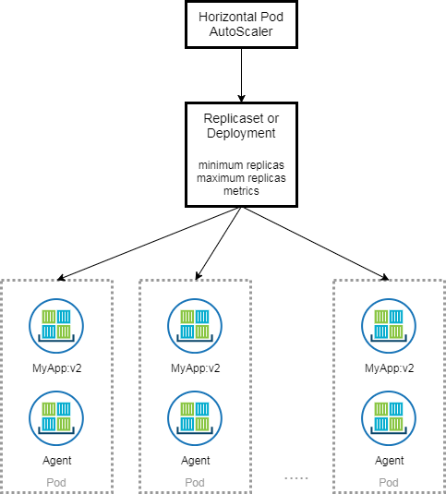
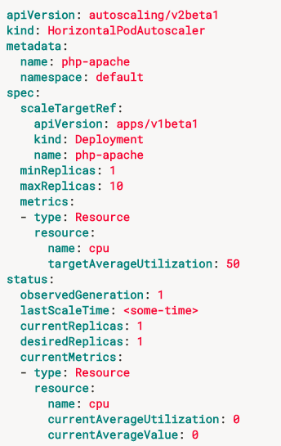
More on Scaling
Horizontal Pod Auto-scaling (HPA)
More on Scaling
Allows you to scale the number of running pods in a replicaset based upon resource (or application custom) metrics.
Notes:
Horizontal Scaling (increasing the instances of an application ie the number of pods in a replicaset
With an app such as nginx you may want to scale based upon CPU usage
For an in memory cache app, you may want to scale based upon memory consumption.
You may want to use custom app metrics.
Horizontal Pod Autoscaling HPA
Heapster keeps track of the metrics
Vertical scaling involves increasing the resources required for a particular pod (not yet fully implemented but in plan)
Cluster Scaling (number of machines in the ICP cluster)

Slide 14
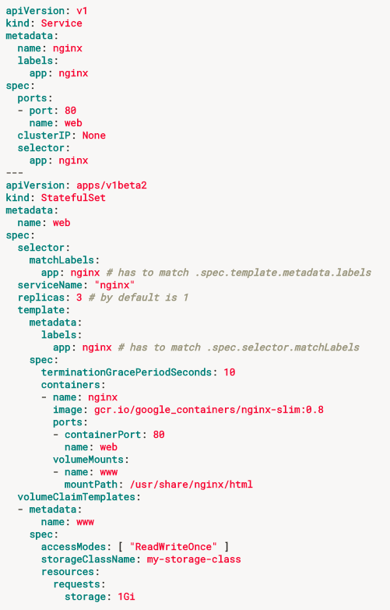
Statefulsets
Similar to replicaset for the purpose of scale or redundancy and/or, statefulsets run one-to-many instances of the desired pod.
Unlike replicasets the are intended for applications requiring state.
Valuable for applications that require:
Stable, unique network identifiers
Stable persistent storage
Ordered graceful deployment and scaling
Ordered graceful deletion and termination
Ordered automated rolling updates
Notes:
StatefulSet is a beta resource, not available in any Kubernetes release prior to 1.5.
As with all alpha/beta resources, you can disable StatefulSet through the --runtime-config option passed to the apiserver.
The storage for a given Pod must either be provisioned by a PersistentVolume Provisioner based on the requested storage class, or pre-provisioned by an admin.
Deleting and/or scaling a StatefulSet down will not delete the volumes associated with the StatefulSet. This is done to ensure data safety, which is generally more valuable than an automatic purge of all related StatefulSet resources.
StatefulSets currently require a Headless Service to be responsible for the network identity of the Pods. You are responsible for creating this Service

Slide 15
Persistence & Storage
There are many types of persistent storage and many provider options.
Some pods must be able to persist data so that if Kubernetes restarts them on the same or another node data loss is avoided.
Kubernetes will re-attach the shared storage when the pod (re)starts.
Storage providers support different retention and recycling policies and the definitions of these are not universal.

Slide 16
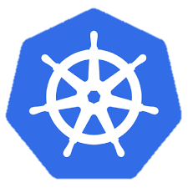
Kubernetes cluster architecture
internet
Master node
Node that manages the cluster
Scheduling, replication & control
Multiple nodes for HA
Worker nodes
Node where pods are run
Docker engine
kubelet agent accepts & executes commands from the master to manage pods
cAdvisor (Container Advisor) provides resource usage and performance statistics
kube-proxy routes inbound or ingress traffic
kubectl
firewall
Kubernetes cluster
Worker node
kube-proxy
kubelet
docker
pod
pod
pod
pod
pod
Master node
pod
cAdvisor
container
container
container
container
authentication authorization
container
APIs
scheduling
actuator
REST
Worker node
kube-proxy
controller manager
Distributed watchable storage (etcd)
kubelet
docker
pod
pod
pod
pod
pod
pod
cAdvisor
container
container
container
container
container

Slide 17
Master node components
Etcd
A highly-available key value store
Stores all cluster data
API Server
Exposes API for managing Kubernetes
Used by kubectrl CLI
Scheduler
Selects the worker node for each pods runs
Controller manager
Daemon that runs controllers (background threads that handle routine tasks in the cluster)
Node Controller – Responsible for noticing and responding when nodes go down
ReplicaSet
Endpoints Controller – Populates the Endpoints object (joins services and pods)
Service Account & Token Controllers – Create default accounts and API access tokens for new namespaces

Slide 18
Kubernetes Architecture: How apps are accessed
Pod
Smallest deployment unit – runs containers
Has its own IP
Shares a PID namespace, network, and hostname
Service
Collection of pods exposed as an endpoint
state and networking info propagated to all worker nodes
Types of service exposure
ClusterIP – Exposes cluster-internal IP
NodePort – Exposes the service on each Node’s IP at a static port
LoadBalancer – Exposes externally using a cloud provider’s load balancer
ExternalName – Maps to an external name (such as foo.bar.example.com)
Kubernetes components
Master Node
Worker Node 1
Pod
Pod
App A
App B
App A Client
App A Service
Worker Node 2
Pod
Pod
App B
App A
App B Client
App B Service
Worker Node 3
Pod
Pod
App A
App B

Slide 19
Deployments and ReplicaSets
Deployment
A set of pods to be deployed together, such as an application
Declarative: Revising a Deployment creates a ReplicaSet describing the desired state
Rollout: Deployment controller changes the actual state to the desired state at a controlled rate
Rollback: Each Deployment revision can be rolled back
Scale and autoscale: A Deployment can be scaled
ReplicaSet
Uses a template that describes the contents of each pod
Ensures that a specified number of pod replicas are running
Deployment
create
ReplicaSet 1
Deployment
rollback
rollout
ReplicaSet 1
ReplicaSet 2
rolling update
pod
pod
pod
ReplicaSet 2
svcA
svcA
svcB
Notes:
https://kubernetes.io/docs/concepts/workloads/controllers/deployment/
https://kubernetes.io/docs/concepts/workloads/controllers/replicaset/
https://kubernetes.io/docs/user-guide/kubectl/v1.6/#rollout
https://kubernetes.io/docs/user-guide/kubectl/v1.6/#rolling-update
https://kubernetes.io/docs/concepts/cluster-administration/manage-deployment/#canary-deployments
Blue-green deployment isn’t built-in to Kubernetes (as of July 2017). Some examples others have built:
https://techbeacon.com/one-year-using-kubernetes-production-lessons-learned
http://www.devoperandi.com/kubernetes-deployment-resource-bluegreen-deploys-for-everyone/

Slide 20
Kubernetes Autoscaling
Horizontal Pod Autoscaling (HPA)
Automatically scales the number of pods in a replication controller, deployment, or replica set
Matches the observed average CPU utilization to the specified target
Fetches metrics in two different ways: direct Heapster access and REST client access
Kubernetes Heapster enables container cluster monitoring and performance analysis
Default config: query every 30 sec, maintain 10% tolerance, wait 3 min after scale-up, wait 5 min after scale-down
$ kubectl autoscale deployment <deployment-name> --cpu-percent=50 --min=1 --max=10 deployment ”<hpa-name>" autoscaled
Creates a horizontal pod autoscaler
An HPA instance
Maintains between 1 and 10 replicas of the pods controlled by the deployment
Maintains an average CPU utilization across all pods of 50%
Notes:
https://kubernetes.io/docs/tasks/run-application/horizontal-pod-autoscale/
https://kubernetes.io/docs/tasks/run-application/horizontal-pod-autoscale-walkthrough/
https://kubernetes.io/docs/user-guide/kubectl/v1.6/#autoscale
https://github.com/kubernetes/community/blob/master/contributors/design-proposals/horizontal-pod-autoscaler.md

Slide 21
Naming
Name
Each resource object by type has a unique name
Namespace
Resource isolation: Each namespace is a virtual cluster within the physical cluster
Resource objects are scoped within namespaces
Low-level resources are not in namespaces: nodes, persistent volumes, and namespaces themselves
Names of resources need to be unique within a namespace, but not across namespaces
Resource quotas: Namespaces can divide cluster resources
Initial namespaces
default – The default namespace for objects with no other namespace
kube-system – The namespace for objects created by the Kubernetes system
Resource Quota
Limits resource consumption per namespace
Limit can be number of resource objects by type (pods, services, etc.)
Limit can be total amount of compute resources (CPU, memory, etc.)
Overcommit is allowed; contention is handled on a first-come, first-served basis

Slide 22
Configuring resources and containers
Label
Metadata assigned to Kubernetes resources (pods, services, etc.)
Key-value pairs for identification
Critical to Kubernetes as it relies on querying the cluster for resources that have certain labels
Selector
An expression that matches labels to identify related resources
ConfigMap
Configuration values to be used by containers in a pod
Stores configuration outside of the container image, making containers more reusable
Secret
Sensitive info that containers need to read or consume
Encrypted in special volumes mounted automatically

Slide 23
Kubernetes management architecture
UI
Master Node
Worker Node 1
Worker Node 2
API
Worker Node 3
CLI
Worker Node n
Registry
Etcd
API Server
Controller Manager Server
Scheduler

Slide 24
Kubectl Commands
Get the state of your cluster
$ kubectl cluster-info
Get all the nodes of your cluster
$ kubectl get nodes -o wide
Get info about the pods of your cluster
$ kubectl get pods -o wide
Get info about the replication controllers of your cluster
$ kubectl get rc -o wide
Get info about the services of your cluster
$ kubectl get services
Get full config info about a Service
$ kubectl get service NAME_OF_SERVICE -o json
Get the IP of a Pod
$ kubectl get pod NAME_OF_POD -template={{.status.podIP}}
Delete a Pod
$ kubectl delete pod NAME
Delete a Service
$ kubectl delete service NAME_OF_SERVICE

Slide 25
Resources
Kubernetes tutorial
https://kubernetes.io/docs/tutorials/kubernetes-basics/
Introduction to container orchestration
https://www.exoscale.ch/syslog/2016/07/26/container-orch/
TNS Research: The Present State of Container Orchestration
https://thenewstack.io/tns-research-present-state-container-orchestration/
Large-scale cluster management at Google with Borg
https://research.google.com/pubs/pub43438.html

